Slide 1

E-commerce Profitability Inventory Optimization
GROUP 23
002813145 MANOGHN KANDIRAJU (857) 423 5798
002697773 RISHWANTH REDDY YADAMAKANTI (737) 881 2194

Slide 2

CONTENTS
INTRODUCTION
CONCEPTUAL DATA MODEL(EER & UML)
RELATIONAL MODEL
BUSINESS
PROBLEM

Slide 3

INTRODUCTION
Convenience is king in the age of digital technology today. Thanks to electronic commerce, or e-commerce, the internet, which was originally used exclusively for information and networking, has evolved into a humming marketplace.
E-commerce, which includes both retail and wholesale, is quickly increasing in popularity and is quickly becoming a crucial component of contemporary business. It gives customers a wide range of options, including a variety of brands, sizes, and product groups including electronics and housewares. Customers can easily examine these possibilities and make selections from many vendors through online apps, encouraging healthy competition.
E-commerce stands out for its ability to offer products at various prices to suit all price points, from budget-friendly to upscale. Online purchasing is becoming widely used as a result of this accessibility. As a result, companies are scrambling to build a strong online presence with transactional capabilities to satisfy customers' changing needs.

Slide 4

BUSINESS PROBLEM
This project focuses on applying data management to enhance many facts about e-commerce online retail operations and data management principles. All issue statements will be discussed and show how data management and analysis can provide answers and insights.
The major data management that we considering is the profit that the e-commerce website is earning considering all the product costs and selling costs which will be incurred to deliver the product to the customers.
By analyzing past data of e-commerce, which includes product categories, which products are getting sold in high demand, product category performance, customer behaviour with the product he bought, Maximizing profit needs gathering historical data on an e-commerce site that includes sales transactions (i.e., order date, product date, product ID, quantity sold, cost, and product categories)

Slide 5
CONCEPTUAL DATA MODEL
ENHANCED ENTITY RELATION (EER)
UNIFIED MODELING LANGUAGE (UML)

Slide 6
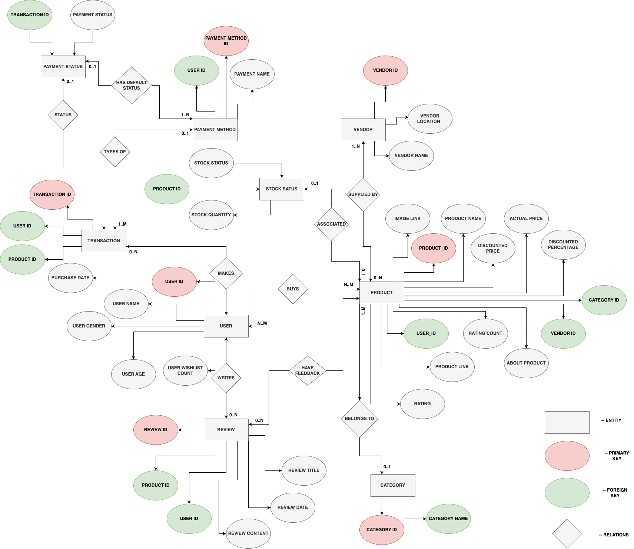
Enhanced Entity Relation (EER)

Slide 7
Product – Category:
Each product belongs to one category.
Each category can have at least one/multiple products.
Product - Vendor:
Each product is supplied by one/many vendors.
Each vendor can supply multiple products.
Product - User:
Each product can be purchased by multiple users.
Each user can purchase multiple products.
Product – Stock Status:
Each product has one stock status.
(Optional) Each stock status is associated with one product.
User - Review:
Each user can write ZERO to multiple reviews.
Transaction - User:
Each user can have ZERO to multiple transactions.
Transaction - PaymentMethod:
Each transaction is associated with one payment method.
Each payment method can be associated with multiple transactions.
Transaction – payment status:
Each transaction has one payment status.
PaymentMethod - PaymentStatus:
Each payment method has one default payment status. (1)
Each payment status can be associated with multiple payment methods. (M)

Slide 8
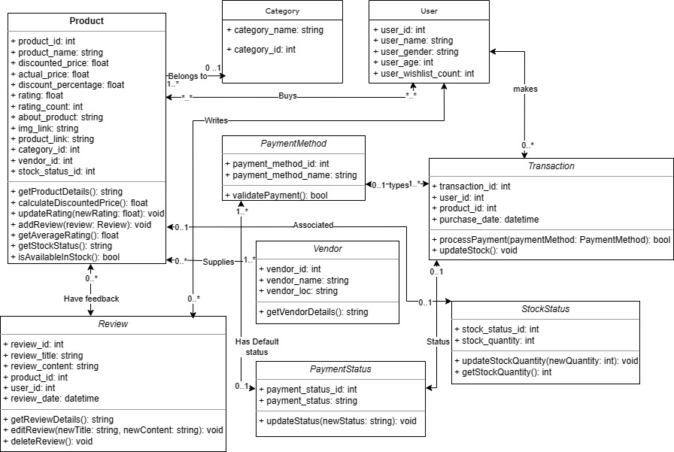
UML

Slide 9
RELATIONAL MODEL
Product(product_id, product_name, id_user_bought, category_id, discounted_price, actual_price, discount_percentage, rating, rating_count, about_product, vendor_id)
product_id: Primary key and NOT NULL
id_user_bought: Foreign key (references User(user_id))
category_id: Foreign key (references Category(category_id))
vendor_id: Foreign key (references Vendor(vendor_id))
Category(category_id, category_name)
category_id: Primary key and NOT NULL
User(user_id, user_name, user_gender, user_age, user_wishlist_count)
user_id: Primary key and NOT NULL
Review(review_id, product_id, user_id, review_title, review_content, review_date)
review_id: Primary key and NOT NULL
product_id: Foreign key (references Product(product_id))
user_id: Foreign key (references User(user_id))

Slide 10

Vendor(vendor_id, vendor_name, vendor_loc)
vendor_id: Primary key and NOT NULL
Transaction(transaction_id, user_id, product_id, purchase_date)
transaction_id: Primary key and NOT NULL
user_id: Foreign key (references User(user_id))
product_id: Foreign key (references Product(product_id))
PaymentMethod(user_id, payment_method_id, payment_method_name)
user_id: Foreign key (references User(user_id))
payment_method_id: Primary key and NOT NULL
ProductImageLink(product_id, img_link, product_link)
product_id: Primary key and Foreign key (references Product(product_id))
StockStatus(stock_status, product_id, stock_quantity)
product_id: Primary key and Foreign key (references Product(product_id))
PaymentStatus(transaction_id, payment_status)
transaction_id: Foreign key (references Transaction(transaction_id))

Slide 11

THANKS !

